Slide 1
Digital Portfolio
STUDENT NAME:SHREEVARSHINI.D
REGISTER NO AND NMID: astvu36336324u18062
DEPARTMENT:BACHULAR OF COMPUTER SCIENCE
COLLEGE: COLLEGE/ UNIVERSITY SREE ABIRAAMI ARTS AND SCIENCE COLLEGE FOR WOMEN\ THIRUVALLUVAR

Slide 2
PROJECT TITLE:
DIGITAL PORTFOLIO in front end development

Slide 3
AGENDA:
1.Problem Statement
2.Project Overview
3.End Users
4.Tools and Technologies
5.Portfolio designs and layout
6.Features and Functionality
7.Results and Screenshots
8.Conclusions
9.Github Link

Slide 4

PROBLEM STATEMENT:
Individuals often lack a centralized and attractive way to showcase their skills, projects, and experience online. This project aims to create a digital portfolio website using HTML, CSS, and JavaScript that allows users to present their professional profile in a responsive and interactive manner.

Slide 5

PROJECT OVERVIEW:
The Digital Portfolio is a personal website built using HTML, CSS, and JavaScript. It showcases an individual’s profile, skills, projects, and achievements in a structured way. The design is responsive and user-friendly, ensuring smooth viewing on all devices. Interactive elements like animations, hover effects, and form validation enhance usability. It serves as a professional branding tool for students, freelancers, and job seekers. The portfolio can be further improved with backend integration and online deployment.

Slide 6

WHO ARE THE END USERS?
Recruiters / Hiring Managers – They visit to check your skills, projects, and qualifications.
Clients – If you’re a freelancer, they use your portfolio to evaluate your work before hiring.
Teachers / Mentors – To review your assignments, projects, or learning progress.
Peers / Collaborators – Other developers or designers who may want to collaborate with you.
General Audience – Anyone interested in your work, blogs, or creative projects.

Slide 7

TOOLS AND TECHNIQUES:
Code Editor – VS Code, Sublime Text, Atom (for writing HTML, CSS, JS).
Version Control – Git & GitHub (for storing and sharing portfolio code).
Browser Dev Tools – Chrome/Edge Dev Tools (for debugging and testing).
Design Tools – Figma, Canva, Photoshop (for creating layouts & graphics).
Frameworks/Libraries – Bootstrap, Tailwind CSS, or jQuery (for faster styling and interaction).
Hosting Platforms – GitHub Pages, Netlify, Vercel (for publishing portfolio online).

Slide 8
POTFOLIO DESIGN AND LAYOUT:
The portfolio has a header with navigation and a hero section introducing the user.
An about section shows profile details and a skills section highlights expertise.
A projects section displays work samples with interactive previews.
Finally, a contact form and footer provide ways to connect.
8

Slide 9
FEATURES AND FUNCTIONALITY:
1.Responsive design
2.Personalized sections
3.Interactive navigation
4.Visual appeal
5.Certificates & projects showcase
6.Contact integration

Slide 10
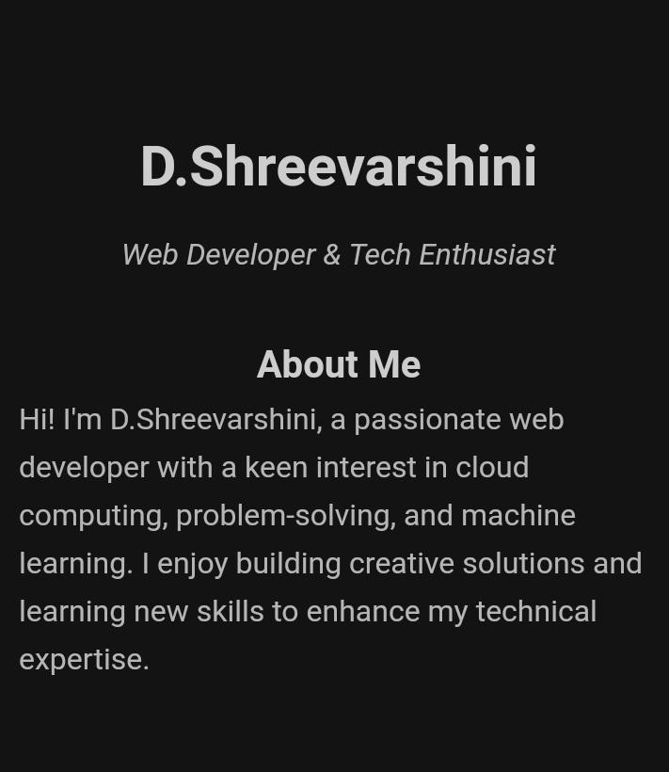
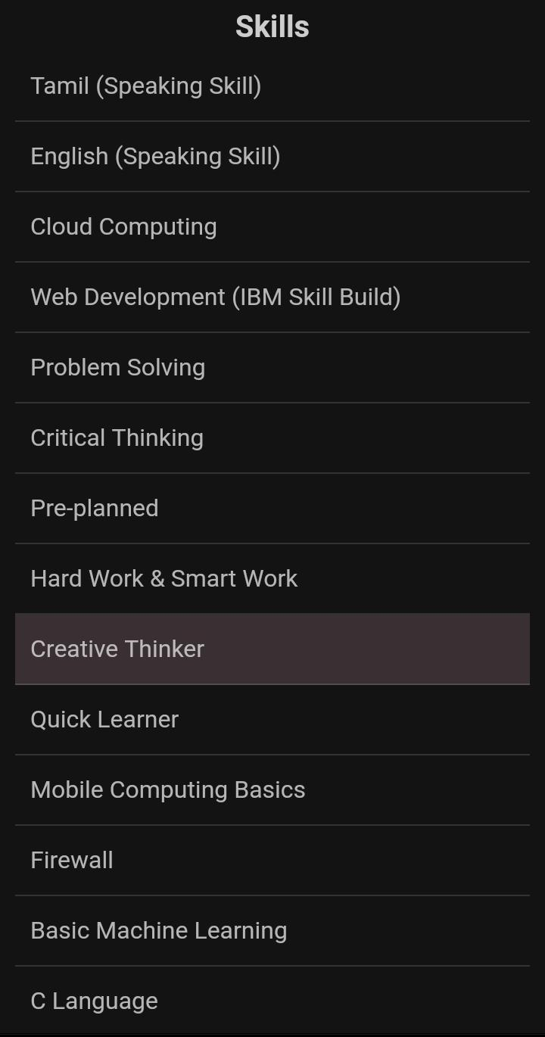
Results and screenshots:

Slide 11
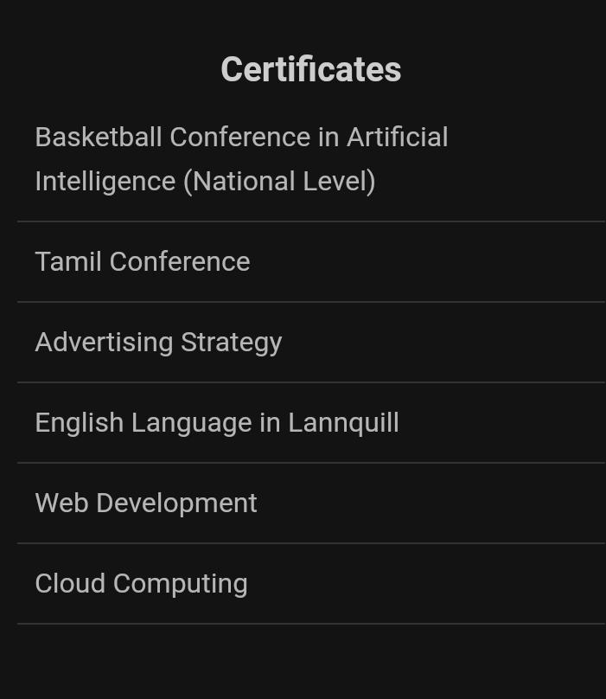

Slide 12
GITHUB AND PORTFOLIO LINK:
https://supriya05122005.github.io/supriya05portfolio/
This is my portfolio and digital and my digital portfolio link.
https://astvu36336324u18062.github.io/shreevarshiniportfolio/

Slide 13
Conclusion:
A digital portfolio serves as a modern platform to showcase personal achievements, skills, and creativity in an interactive and visually appealing way. By using HTML, CSS, and Javascript, it becomes responsive, user-friendly, and accessible across all devices. It not only highlights academic and professional accomplishments but also demonstrates technical expertise in web development. Overall, a digital portfolio acts as a powerful tool for self-presentation, career opportunities, and personal growth in the digital era.

